Slide 1
Better Recognition of Patients with Hypercapnic Respiratory Failure
Brian Locke, MD
T32 Fellow. Division of Pulmonary, Critical Care, and Occupational Pulmonary Medicine
Wayne Richards MS, Joseph Finkelstein MD PhD MA, Jeanette Brown MD PhD, Ramkiran Gouripeddi MBBS MS, Krishna Sundar MD Departments of Internal Medicine and Biomedical Informatics
This research was supported by the National Institutes of Health under Ruth L. Kirschstein National Research Service Award 5T32HL105321 and the American Thoracic Society Academic Sleep and Pulmonary Integrated Research/Clinical Fellowship (ASPIRE) Program

Slide 2
Overview
The problem: Hypercapnic Respiratory failure is highly consequential and not identified reliably
What we’ve done: Identified predictors of hypercapnic respiratory failure
What we plan to do: EHR-based prediction of hypercapnia probability and computable phenotype
Further Reading on Methods Issues: QR codes

Slide 3

What is Hypercapnic Respiratory Failure?
Insufficient Ventilation → CO₂ Levels Rise
Diseases that cause hypercapnia (= ↑ Arterial CO₂)
↑ Requirement | ↓ Capacity | ↓ Drive to Breathe
COPD (inefficient ventilation) Obesity (↑CO2 production) | Neuromuscular disease COPD Obesity | Opiates Metabolic Alkalosis
Notes:
There are two purposes to the respiratory system: get enough oxygen to the blood, and get enough CO2 out of the blood.
TODO: [ ] back to the schema
[ ] Decrease to ONLY low ventilation = CO2 goes up, like in the valley with pollution.

Slide 4


Hypercapnia is common, likely becoming more so, and is associated with substantial morbidity
Population-standardized prevalence PaCO2 > 45 mmHg after excluding iatrogenic causes:
150* per 100,000 person/year
Common contributors to Hypercapnic Respiratory Failure:
Advanced Age
Opiate Use
Obesity
Advanced Lung Dz
Multimorbidity
Inpatient ICD code for Hypercapnic Respiratory Failure
23% 30d readmission rate
Same as CHF, more than MI
Usually (66%) with recurrent hypercapnia
Notes:
[ ] todo: Simplify

Slide 5
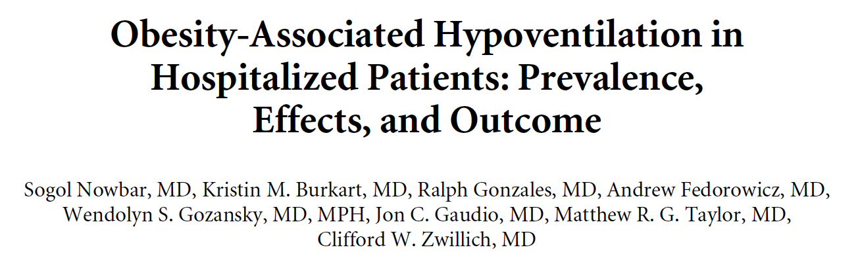
Patients with hypercapnia are identified unreliably and late in their illness
Published 2003; 3 hospitals, Denver
ABG on all inpatients BMI 35+
31% with unrecognized hypercapnia
Notes:
involved obtaining an arterial blood gas on all adult patients with obesity (BMI > 35 kg/m²). After excluding ten patients with FEV1/FVC <50% or prior lung resection, 32 patients using opiates, and 85 that could not or did not consent, they found that 47 of 150 (31%) patients had hypercapnia with a pH lower than 7.42. 48% (14 of 29) with a BMI above 50 kg/m² had hypercapnia using an elevation-adjusted threshold (5200ft study elevation of the 3 study centers).

Slide 6
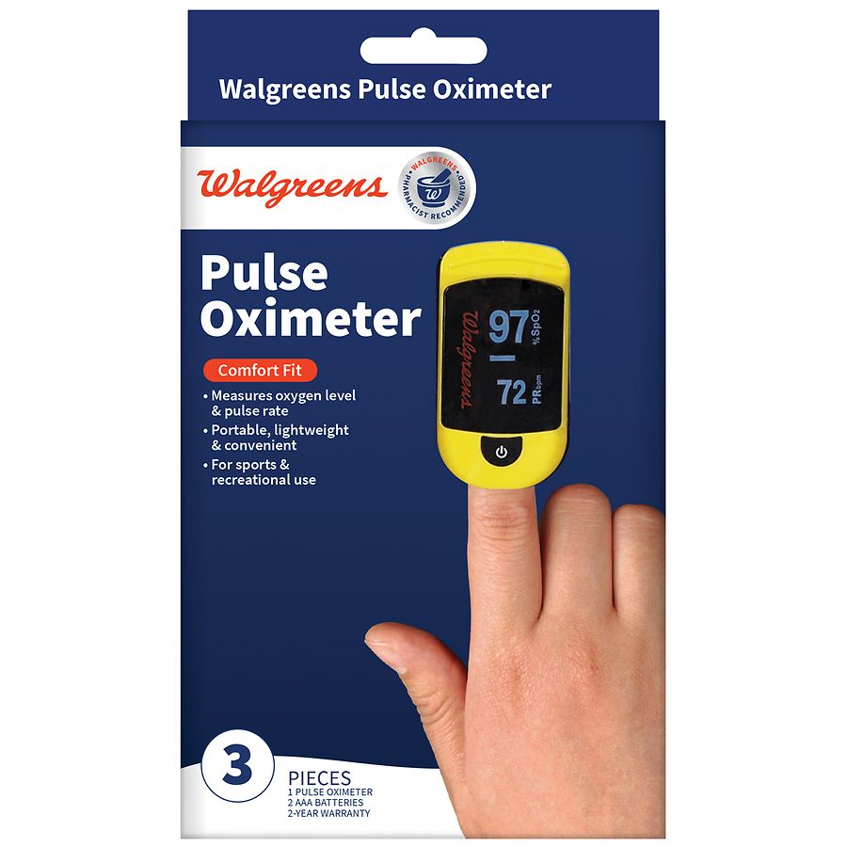
Surrogate Needed
Hypoxemic (Low O2) Respiratory Failure | Hypercapnic (High CO2) Respiratory Failure
Low arterial blood oxygen tension | High arterial blood carbon dioxide tension
Definitive diagnosis by Arterial Blood Gas | Definitive diagnosis by Arterial Blood Gas
Reliably* Identified by Pulse Oximetry | Limited non-invasive testing
Immediate Life Threat if Severe | Indicates potentially treatable excess risk
Applied widely since 1980s with improved recognition | No systematic Identification

Slide 7
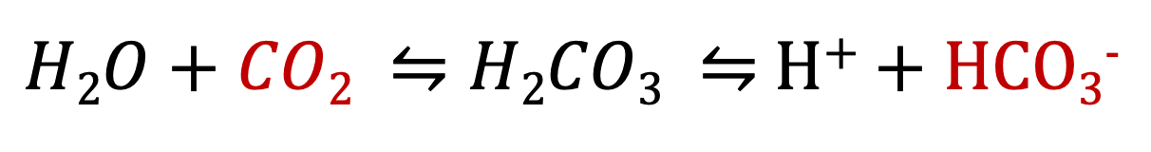
Role of HCO₃⁻ in Diagnosis of Hypercapnia
$H2O+CO2 ⇋H2CO3 ⇋$ H⁺ + HCO₃⁻
When Arterial CO₂ goes up, kidneys retain bicarbonate (HCO₃⁻) to maintain blood pH homeostasis
HCO₃⁻ is widely available (on basic metabolic panel) and may work as a surrogate
Notes:
Henderson Hasselbach is a minimally stochastic predict of what HCO3 will be if PCO2 and pH are known – it will never be wrong
Boston-Acid Base are simplified empirical short cuts that describe behavior – they are not rigorously derived.
Greatly simplify this slide
Boston Acid-Base “Rules*”:
Acute: ↑ CO₂ by 10 mmHg ↑ HCO₃⁻ by 1 mEq/L
Chronic: ↑ CO₂ by 10 mmHg ↑ HCO₃⁻ by 4 mEq/L
Thus,

Slide 8
Does HCO₃⁻ work in acutely ill patients?
Proof of concept: HCO₃⁻ works in stable outpatients
But,
De-identified, patient-level data
Federated Health Record Data
80 US Healthcare Orgs (mostly AMCs)
Allegedly, reconciled inter-institution linkage
NOT able to identify the source institution
Notes:
Expand this Some

Slide 9

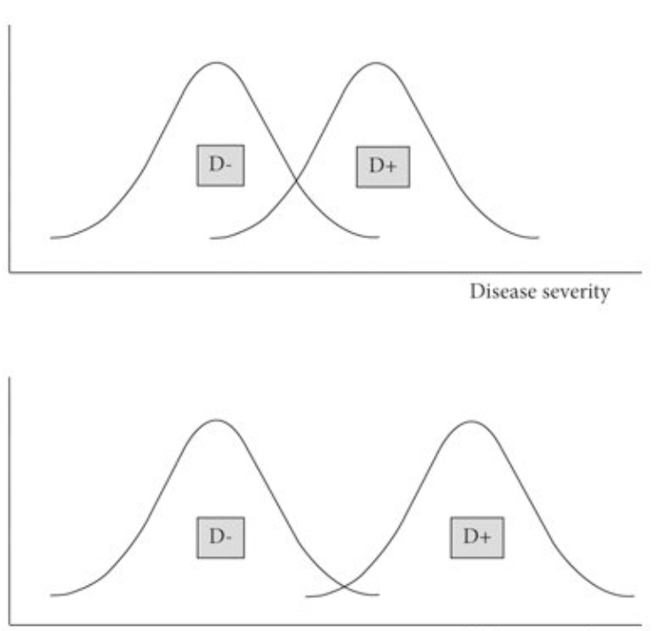
Spectrum bias (effect)
Spectrum Bias
BMJ 2016;353:i3139
Target population: patients whom a clinician should consider hypercapnia.
Data source: all encounters in TriNetX research network during 2022 who met:
Predisposing condition: COPD, CHF, Obesity…
Diagnostic Testing Sent: VBG, ABG
Related Diagnosis: Other Resp Failure
Related Management: Vent. Support
No HCO₃⁻ criteria (incorporation bias)
Inpatient, Outpatient, Emergency Visits
1st encounter meeting each criteria
Se = “Correct in people with the disease”
Sp = “Correct in people without the disease”
Notes:
Cite this as: BMJ 2016;353:i3139
http://dx.doi.org/10.1136/bmj.i3139
The spectrum effect describes the variation in performance of tests for prediction, screening, and diagnosis of disease among different population subgroups.
Thus, you want to assess the performance of the test ONLY on the types of patients who you would use the test on.

Slide 10



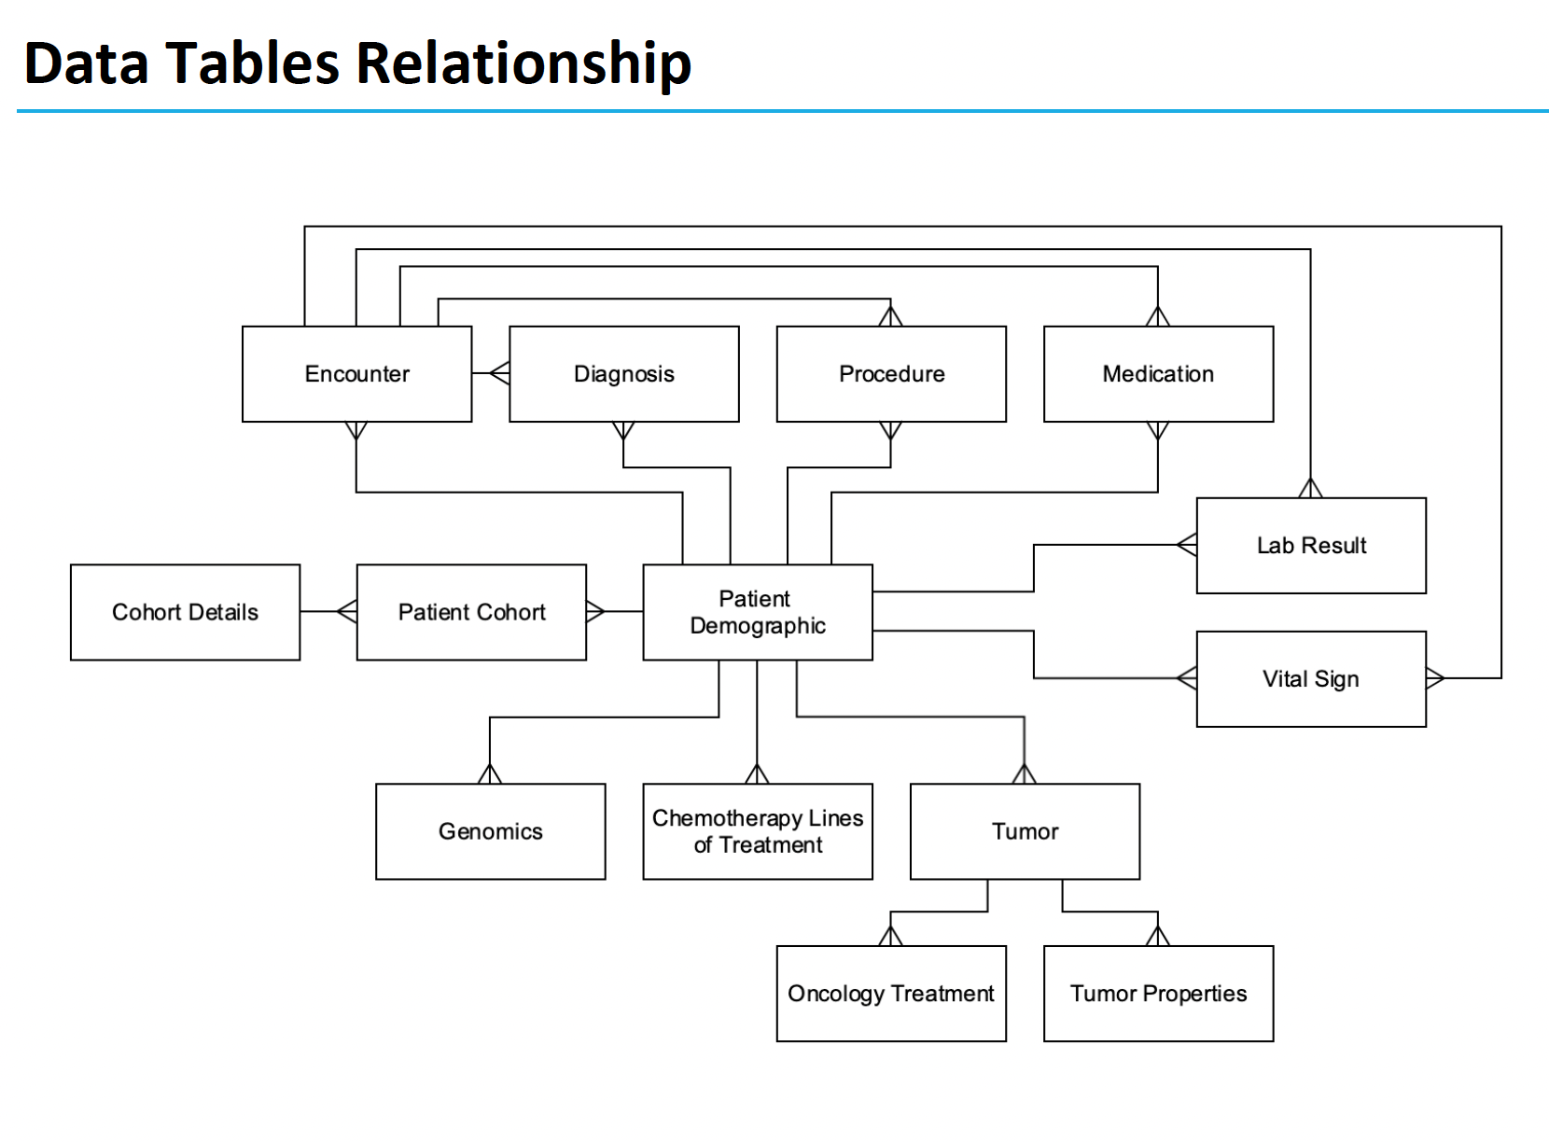
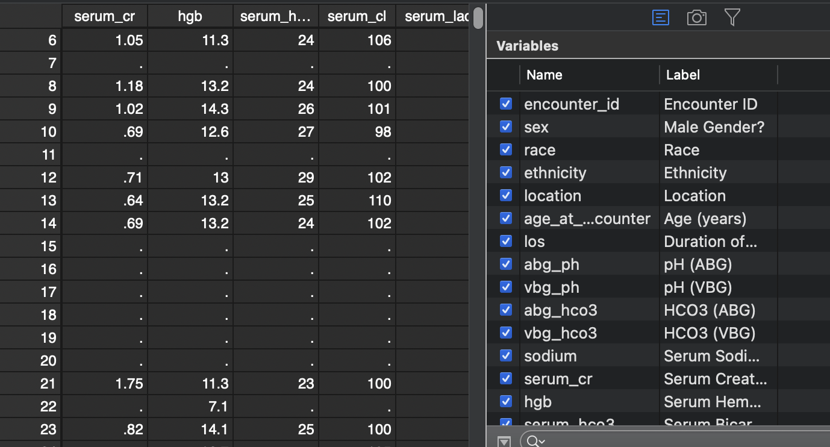
Data Preprocessing
50+ gb (entire health record for included patients)
Elements & Encounters of Interest ~2 million patients
Wayne Richards (DBMI MSc)

Slide 11
Missing Data in Health Records
Interventional Trial → Observational Study: lose group assignment
Prospective → Retrospective: lose control of what data you collect
Research Purpose → Secondary Use: informed presence
The Estimand
True Physiology
What the clinician recognizes
What testing is obtained
What results are stored & accessible in EHR
What data is submitted, harmonized, and linked in TriNetX
Non-random variation with respect to hypercapnia
Informed Presence Bias
Unclear factors influencing quality
Methods/Data Quality Issues
Notes:
Discuss informed presence.
Patient’s true physiology @ presentation.
What the clinician suspects
What testing is obtained
What results are stored a & accessible in (local) EHR
What data is submitted, harmonized, and linked in TriNetX
Data harmonization: data comes from many institutions, so need to make sure data is getting submitted in an interoperatble way.
Linkage- how do you combine data from differenct sources and realize that some entries refer to the same person?
Perhaps go through and give metrics for how much the original data varied from this: https://www-ncbi-nlm-nih-gov.ezproxy.lib.utah.edu/pmc/articles/PMC5051581/ ←- different categories/metrics of data quality
BMI: 10-100 - BMI is truncated at 50 to avoid identifying notable patients.
RR: 2-75 --- // whats going on with respiratory rates below 4? - do we think these are coding errors or peri-arrest? — seems like they are preferentially in the ventilation procedure code group… perhaps this is an error in how IMV vs spontaneous breaths are coded in the dataset? I think nothing to do here yet.
Temp(F): 30 - 110
Sys BP: 30 - 350
Dia BP: (15 on revamp) 20 - 250
SpO2: 50-100
HR: 15 - 300
Temp: outside 70F - 110F; 20c - 43c
*** If temperature is between 20-43, can be assumed to represent C and converted to Fahrenheit
Example methods discussion from supplement here: https://www.ncbi.nlm.nih.gov/pmc/articles/PMC8404019/)
“Step I. Data preprocessing
To ensure data quality and hypothesis of clustering algorithm was satisfied, the following preprocessing steps were performed:
(1) data cleaning
Data cleaning was performed on vital monitoring and lab result data to filter out erroneous measurement and correct unsuccessful default data conversion. We examined the statistics and distribution plot of selected clinical variables and FiO2 which were used in calculation of PaO2/FiO2 ratio (P/F ratio). Erroneous measurement such as pH < 6 were removed from the dataset. Additional data conversion was performed on entries where the default data conversion is unsuccessful. For example, bicarbonate measure recorded as “>45” was converted to 45 and age recorded as “>89” was converted to 89. For calculation of P/F ratio, if multiple arterial blood gas test (ABG test) results were recorded at same timestamp with different FiO2 settings, P/F ratio were marked as missing value since we were unable to map PaO2 measurements to corresponding FiO2 ventilator settings.
(2) distribution transformation
We examined skewness and distribution plot of selected variables and applied log transformation on variables with long trails (e.g. Blood Urea Nitrogen, Creatinine).
(3) extreme value bounding
Due to clustering algorithms are sensitive to outliers, we bounded all measurements to their 0.02 and 0.98 percentile respectively to eliminate erroneous and extreme values.
(4) normalization
Normalization was performed for each variable. Categorical variables are encoded by 0 and 1.
(5) removing observations with missing variables
Large number of missing values indicate high degree of information loss. To ensure observations in eICU derivation cohort contains adequate information for clustering, all patients with 10 or more missing variables were removed.
(6) missing value imputation
We observed missing values in eICU dataset under different variable extraction window.¹ Due to clustering algorithm did not accept missing value as input, data imputation is required. We assumed: variables are missing at random (MAR). Multiple imputation by chained equations (MICE) was applied to the dataset and all clinical variables were modeled by linear regression.^{2,3} MICE generated 10 independent datasets in the imputation procedure. For visualization, the last imputed dataset was selected to generate plots. For modelling, standard clustering was performed on each of the imputed datasets, and their parameters were pooled to obtain the final model.
(7) correlation analysis
Correlation matrix of selected clinical variables was analyzed.
Step II. Understanding the clustering structure
Data points can group in non-overlapping balls with clear boundaries in between or group in one ball that can be partitioned into multiple subgroup in high dimensional space. To understand the grouping structure of points, we applied a clustering algorithm called ordering points to identify the clustering structure (OPTICS).⁴ OPTICS is a density-based model which can detect clusters in various densities. A reachability plot was produced with OPTICS, which was used to determine if data points are group in non-overlapping balls. If the reachability plot consists multiple segmented curves with points on the tail of one curve significantly higher than most points on another curve, points in the underlying dataset are likely group in non-overlapping balls. If the reachability plot consists one smooth curve, points in the underlying dataset are likely to group in one ball. The reachability plot for both eICU derivation and validation cohort were smooth curves, indicating that points were grouped in one ball and that partition clustering model was preferred.
Step III. Clustering
We used centroid based K-means clustering (K-Means) as the clustering model in this study. To determine the optimal number of cluster k, we examined the Gap statistics and the Gap* statistics. Consensus clustering (CC) is used the cross validation the cluster assignment of K-Means.
To evaluate the clustering result, we considered both theoretical and practical factors including: (1) Goodness of fit (2) Adequate large cluster size (3) Salient difference in clinical characteristics between different phenotypes. Phenotypes were visualized by: (1) t-distributed stochastic neighbor embedding plots (t-SNE)⁵ (2) Line plot of variables normalized by 3 phenotype population mean (3) Rank plot of variables normalized by 2 phenotype population mean.
The optimal number of cluster k is determined by the Gap statistics and the Gap* statistics. Gap statistic compares the total intra-cluster variation for number of cluster k with their expected values under the null hypothesis that distribution has no obvious cluster and is calculated as log of Intra-cluster sum of the pairwise distances.⁶ The difference between Gap statistics and Gap* statistics is that Gap* statistics remove the log function.⁷ In some cases, Gap statistics tend to overestimate the number of clusters but may outperform in the overlapping group cases. In these cases, the optimal number of cluster is determined by the highest Gap statistics value or identifying the first number of cluster k, such that Gap_{n}(k) ≥ Gap_{n}(k + 1) − s_{k+1}. Both Diff value in Gap statistics plot and Gap* statistics plot suggested that optimal number of clusters is 3.
To cross validate the cluster assigned by K-Means, we applied consensus clustering on same data to compare the difference in cluster assignments and phenotype clinical characteristics. Consensus clustering aims to group points into clusters by evaluating degree of confidence or “consensus” of two points are grouped into one cluster under the uncertainty of repeated subsampling.⁸ Pairwise consensus value is defined as “the proportion of time in which two point are grouped in the same cluster” and a high consensus value indicates high goodness of fit. We performed consensus clustering under the ConsensusClusterPlus implementation in R.⁹ We observe a sharp decline in Delta Area plot of CDF from 3 class to 4 class, indicating optimal number of clusters is likely to be 3. Under cluster number=3, cluster consensus for all cluster was above 0.8 and consensus matrix plot suggested that goodness of fit was high.
To further test the stability and robustness of K-Means model, we evaluated the following factors: (1) changes in clinical characteristics of phenotypes between models trained on eICU derivation cohort and eICU validation cohort (2) variance of fitted parameters on multiple imputed datasets by MICE (3) changes in clinical characteristics of each phenotype by altering the clinical variable extraction window from +/-8 hours to +/-12 and +/-24 hours. The clinical characteristics of phenotype generated by K-Means were stable cross all the above tests.
“

Slide 12
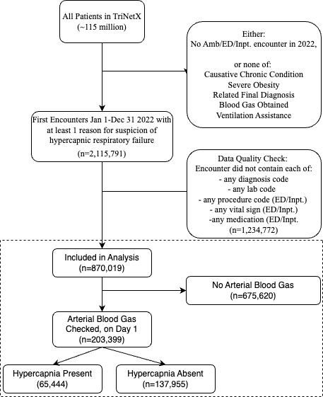
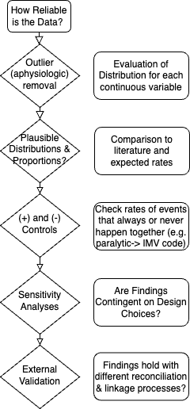
Data Cleaning
Notes:
For a given encounter, the institution must have submitted some data (any data) for each requested data elements (labs, diagnoses, etc.).
Data validation measures:
Positive controls: if paralytic, expect intubation
Negative controls: <BMI 30 in OHS
- See if distribution changed at all with exclusions.
External validation***
Data cleaning process:
Exclusion of records:
Encounter
Excluding spurious data:
Assessment of the resulting data quality
Perhaps go through and give metrics for how much the original data varied from this: https://www-ncbi-nlm-nih-gov.ezproxy.lib.utah.edu/pmc/articles/PMC5051581/ ←- different categories/metrics of data quality
Is the data quality sufficient?
Restricted analyses to single-encounter data (cross-sectional)
Harmonization (data coming from different centers)
Linkage? (same person identified from
BMI: 10-100 - BMI is truncated at 50 to avoid identifying notable patients.
RR: 2-75 --- // whats going on with respiratory rates below 4? - do we think these are coding errors or peri-arrest? — seems like they are preferentially in the ventilation procedure code group… perhaps this is an error in how IMV vs spontaneous breaths are coded in the dataset? I think nothing to do here yet.
Temp(F): 30 - 110
Sys BP: 30 - 350
Dia BP: (15 on revamp) 20 - 250
SpO2: 50-100
HR: 15 - 300
Temp: outside 70F - 110F; 20c - 43c
*** If temperature is between 20-43, can be assumed to represent C and converted to Fahrenheit
Example methods discussion from supplement here: https://www.ncbi.nlm.nih.gov/pmc/articles/PMC8404019/)
“Step I. Data preprocessing
To ensure data quality and hypothesis of clustering algorithm was satisfied, the following preprocessing steps were performed:
(1) data cleaning
Data cleaning was performed on vital monitoring and lab result data to filter out erroneous measurement and correct unsuccessful default data conversion. We examined the statistics and distribution plot of selected clinical variables and FiO2 which were used in calculation of PaO2/FiO2 ratio (P/F ratio). Erroneous measurement such as pH < 6 were removed from the dataset. Additional data conversion was performed on entries where the default data conversion is unsuccessful. For example, bicarbonate measure recorded as “>45” was converted to 45 and age recorded as “>89” was converted to 89. For calculation of P/F ratio, if multiple arterial blood gas test (ABG test) results were recorded at same timestamp with different FiO2 settings, P/F ratio were marked as missing value since we were unable to map PaO2 measurements to corresponding FiO2 ventilator settings.
(2) distribution transformation
We examined skewness and distribution plot of selected variables and applied log transformation on variables with long trails (e.g. Blood Urea Nitrogen, Creatinine).
(3) extreme value bounding
Due to clustering algorithms are sensitive to outliers, we bounded all measurements to their 0.02 and 0.98 percentile respectively to eliminate erroneous and extreme values.
(4) normalization
Normalization was performed for each variable. Categorical variables are encoded by 0 and 1.
(5) removing observations with missing variables
Large number of missing values indicate high degree of information loss. To ensure observations in eICU derivation cohort contains adequate information for clustering, all patients with 10 or more missing variables were removed.
(6) missing value imputation
We observed missing values in eICU dataset under different variable extraction window.¹ Due to clustering algorithm did not accept missing value as input, data imputation is required. We assumed: variables are missing at random (MAR). Multiple imputation by chained equations (MICE) was applied to the dataset and all clinical variables were modeled by linear regression.^{2,3} MICE generated 10 independent datasets in the imputation procedure. For visualization, the last imputed dataset was selected to generate plots. For modelling, standard clustering was performed on each of the imputed datasets, and their parameters were pooled to obtain the final model.
(7) correlation analysis
Correlation matrix of selected clinical variables was analyzed.
Step II. Understanding the clustering structure
Data points can group in non-overlapping balls with clear boundaries in between or group in one ball that can be partitioned into multiple subgroup in high dimensional space. To understand the grouping structure of points, we applied a clustering algorithm called ordering points to identify the clustering structure (OPTICS).⁴ OPTICS is a density-based model which can detect clusters in various densities. A reachability plot was produced with OPTICS, which was used to determine if data points are group in non-overlapping balls. If the reachability plot consists multiple segmented curves with points on the tail of one curve significantly higher than most points on another curve, points in the underlying dataset are likely group in non-overlapping balls. If the reachability plot consists one smooth curve, points in the underlying dataset are likely to group in one ball. The reachability plot for both eICU derivation and validation cohort were smooth curves, indicating that points were grouped in one ball and that partition clustering model was preferred.
Step III. Clustering
We used centroid based K-means clustering (K-Means) as the clustering model in this study. To determine the optimal number of cluster k, we examined the Gap statistics and the Gap* statistics. Consensus clustering (CC) is used the cross validation the cluster assignment of K-Means.
To evaluate the clustering result, we considered both theoretical and practical factors including: (1) Goodness of fit (2) Adequate large cluster size (3) Salient difference in clinical characteristics between different phenotypes. Phenotypes were visualized by: (1) t-distributed stochastic neighbor embedding plots (t-SNE)⁵ (2) Line plot of variables normalized by 3 phenotype population mean (3) Rank plot of variables normalized by 2 phenotype population mean.
The optimal number of cluster k is determined by the Gap statistics and the Gap* statistics. Gap statistic compares the total intra-cluster variation for number of cluster k with their expected values under the null hypothesis that distribution has no obvious cluster and is calculated as log of Intra-cluster sum of the pairwise distances.⁶ The difference between Gap statistics and Gap* statistics is that Gap* statistics remove the log function.⁷ In some cases, Gap statistics tend to overestimate the number of clusters but may outperform in the overlapping group cases. In these cases, the optimal number of cluster is determined by the highest Gap statistics value or identifying the first number of cluster k, such that Gap_{n}(k) ≥ Gap_{n}(k + 1) − s_{k+1}. Both Diff value in Gap statistics plot and Gap* statistics plot suggested that optimal number of clusters is 3.
To cross validate the cluster assigned by K-Means, we applied consensus clustering on same data to compare the difference in cluster assignments and phenotype clinical characteristics. Consensus clustering aims to group points into clusters by evaluating degree of confidence or “consensus” of two points are grouped into one cluster under the uncertainty of repeated subsampling.⁸ Pairwise consensus value is defined as “the proportion of time in which two point are grouped in the same cluster” and a high consensus value indicates high goodness of fit. We performed consensus clustering under the ConsensusClusterPlus implementation in R.⁹ We observe a sharp decline in Delta Area plot of CDF from 3 class to 4 class, indicating optimal number of clusters is likely to be 3. Under cluster number=3, cluster consensus for all cluster was above 0.8 and consensus matrix plot suggested that goodness of fit was high.
To further test the stability and robustness of K-Means model, we evaluated the following factors: (1) changes in clinical characteristics of phenotypes between models trained on eICU derivation cohort and eICU validation cohort (2) variance of fitted parameters on multiple imputed datasets by MICE (3) changes in clinical characteristics of each phenotype by altering the clinical variable extraction window from +/-8 hours to +/-12 and +/-24 hours. The clinical characteristics of phenotype generated by K-Means were stable cross all the above tests.
“

Slide 13
 | Total | No ABG Obtained | ABG Obtained
 | N=879,019 | N=675,620 | N=203,399
Encounter Characteristics
Ambulatory | 39% (343,699) | 50% (334,457) | 5% (9,242)
Emergency | 20% (175,792) | 22% (146,066) | 15% (29,726)
Inpatient | 41% (359,528) | 29% (195,097) | 81% (164,431)
Critical Care Services Billed | 13% (111,320) | 6% (41,976) | 34% (69,344)
Patient Characteristics
Age (years) | 58 (±18) | 57 (±18) | 61 (±17)
Female | 53% (465,854) | 55% (373,158) | 46% (92,696)
BMI kg/m² | 34 (±9) | 35 (±9) | 29 (±7)
CHF | 17% (145,615) | 16% (106,492) | 19% (39,123)
CKD | 15% (128,047) | 14% (94,048) | 17% (33,999)
COPD | 16% (144,127) | 16% (106,788) | 18% (37,339)
Neuromuscular Disease | 4% (35,539) | 4% (27,725) | 4% (7,814)
OSA | 21% (188,757) | 24% (160,082) | 14% (28,675)
Diuretics (outpatient) | 38% (334,400) | 38% (256,188) | 38% (78,212)
Opiate (outpatient) | 59% (518,493) | 57% (387,725) | 64% (130,768)
Serum Bicarbonate (mEq/L) | 24.6 (±4.7) | 25.0 (±4.1) | 23.6 (±5.7)
Outcomes
Non-invasive Ventilation? | 4% (32,542) | 2% (15,352) | 8% (17,190)
Invasive Mechanical Ventilation | 6% (52,533) | 1% (10,054) | 21% (42,479)
CO2 ≥ 45 mmHg? | 32% (64,544) |  | 32% (64,544)
Notes:
No p-values.

Slide 14
Statistical Analyses:
Index Test: Calendar day of encounter start: Serum Total CO₂ (aka Bicarbonate, HCO₃⁻) from a Basic Metabolic Panel | Reference Standard: Calendar day of encounter start (+) An ABG showing PaCO2 over 45 mmHg (-) No ABG showing PaCO2 over 45 mmHg
Statistical Analysis | Purpose
Receiver Operating Characteristic (ROC) Curve Analysis | How well does HCO₃⁻ separate patients with ↑CO₂ from those without (discrimination)?
ROC-Generalized Linear Modeling | What characteristics independently associate with better or worse discrimination?
Interval Likelihood Ratios (iLR) | How much does the degree of HCO₃⁻ elevation change the likelihood of ↑CO₂ being present?

Slide 15
Results:
Notes:
https://www.jclinepi.com/article/S0895-4356(23)00198-1/fulltext
Area under the receiver operating characteristic curve (AUROC)=the probability that
a classifier will correctly rank a randomly chosen person with the disease higher
than a randomly chosen person without the disease (that is, the area under a plot of
sensitivity against (1−specificity))
Hosmer and Lemeshow (2000, p. 162) suggest the following general rule for interpreting the
area under the ROC curve:
ROC =0.5 suggests no discrimination (i.e., no better than flipping a coin)
0.7 ≤ ROC < 0.8 is considered acceptable discrimination
0.8 ≤ ROC < 0.9 is considered excellent discrimination
ROC ≥ 0.9 is considered outstanding discrimination (extremely unusual to observe this in
practice)

Slide 16

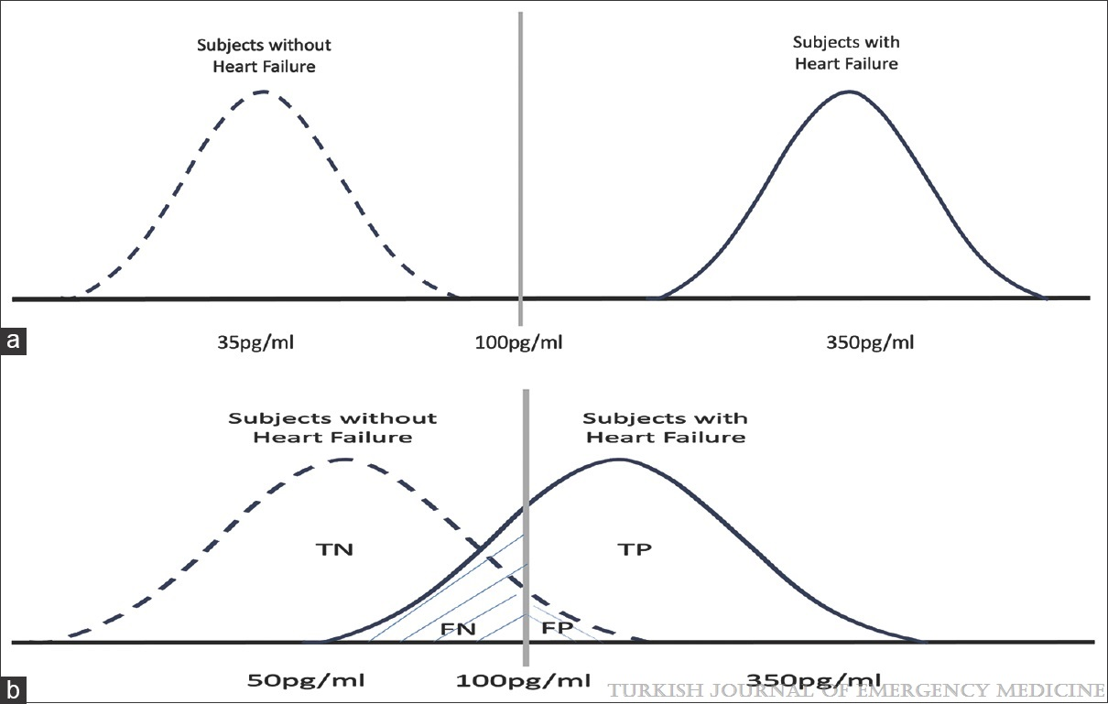
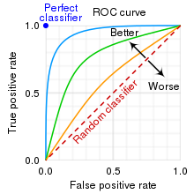
The Walking Man Approach to ROC. Jour Clin Epi 2023
Notes:
Two different BNP distribution graphs of the subjects groups with and without heart failure. TN: true negative, TP: true positive, FN: false negative, FP: false positive (a) An ideal diagnostic test would yield sensitivity and specificity of 100%, resulting in non-overlapping BNP distribution graphs for individuals with and without heart failure. (b) real-world scenarios tend to involve overlapping distributions; sensitivity and specificity values are not 100%
Receiver operating characteristic curve analysis in diagnostic accuracy studies: A guide to interpreting the area under the curve value
Çorbacıoğlu, Şeref Kerem; Aksel, Gökhan
Turkish Journal of Emergency Medicine23(4):195-198, Oct-Dec 2023.
doi: 10.4103/tjem.tjem_182_23

Slide 17
Results:
Notes:
Pepe MS. An interpretation for the ROC curve and inference using GLM procedures. Biometrics. 2000;56:352-359.
And
https://academic.oup.com/aje/article/168/1/89/123767?login=false

Slide 18
Results:

Slide 19
Unadjusted distribution:

Slide 20
Does considering potassium help?
Rationale:
If you have an elevated HCO₃⁻, it is either:
true positive (↑HCO₃⁻ elevated in response to ↑CO₂) or
a false positive (↑HCO₃⁻ elevated for another reason)
Defined as a primary metabolic alkalosis
Most primary metabolic alkaloses cause hypokalemia
diuretics, vomiting, hypovolemia… (high aldosterone)
Therefore, high bicarbonate with normal/high potassium is more likely a true positive

Slide 21

What are interval likelihood ratios?
Sensitivity (right answer in D+), Specificity (right answer in D-)
Dichotomous Test Result, Dichotomous Disease State
Likelihood Ratio (Pre-test Odds * [+LR or –LR] = Post-test Odds)
Dichotomous Test Result, Dichotomous Disease State
Interval Likelihood Ratio (Pre-test Odds * LR_{int} = Post-test Odds)
Continuous Test Result (broken into intervals), Dichotomous Disease State
Reporting Accuracy of Continuous Tests. Jour Clin Epi 2022
Notes:
The data alone cannot tell you what HCO₃⁻ threshold to use
How bad is a false negative (missing hypercapnia) compared to a false positive (incorrectly suggesting hypercapnia)? No data exists to inform that choice
Dichotomizing a continuous measure discards useful information and is misleading near the threshold
HCO₃⁻ 27 mEq/L has been used: 28 mEq/L and 35 mEq/L are much different.
Sensitivity and Specificity don’t mean what clinicians think they mean.
‘Reverse Probability’; SpIN & SnOUT; Conflation with PPV/NPV
Simplify this – or maybe take this one out? Focus is on introducing the concept of an interval likelihood ratio.
Rule of 100
Backward time order
Are not test characteristics; they are characteristics of the test AND the population (because they vary with covariates related to disease severity)

Slide 22
Results:
Notes:
↓HCO₃⁻ & ↓K⁺ = Unlikely hypercapnic
↑HCO₃⁻ & ↑K⁺ = Likely hypercapnic
↓HCO₃⁻ & ↑K⁺, ↑HCO₃⁻ & ↓K⁺ = less strong evidence for or against
M.A. Kohn / Journal of Clinical Epidemiology 141 (2022) 157–160 Key concepts in clinical epidemiology: reporting on the accuracy of
continuous tests

Slide 23
‘Biological’ Limitations:
‘Acute’, transient hypercapnia will be under-identified.
The test will miss if there is inadequate time for kidneys to retain HCO₃⁻
Calendar-day time matching*
Is this a bad thing?
recurrent or persistent = potential for helpful intervention
Favor False Negative (HCO₃⁻ low, PaCO₂ high) | Favor False Positive (HCO₃⁻ high, PaCO₂ low)
Hypercapnia not present long enough Hypercapnia not severe enough Kidneys don’t work well enough Superimposed metabolic acidosis | Something else makes the HCO₃⁻ high (a primary metabolic alkalosis)
Notes:
Biological vs non-biological limitations

Slide 24







‘Data/Methods’ Limitations:
P(ABG) = 0.5
P(ABG) = 0.25
‘Partial Verification’: hypercapnia status is only ascertained in patients who get an ABG.
Analysis: Among patients who have ABGs checked
Target: Among all patients who may have hypercapnia
The probability of getting an ABG is variable and idiosyncratic
Inverse probability of blood-gas weighting?
Missing data is tricky
True Status (unobserved)
Observed w/ Hypercapnia
Weighted by Inverse of Prob
The Missing Indicator Method.
CMAJ 2012
Notes:
DOI:https://doi.org/10.1016/j.jclinepi.2022.01.022
If you assume that the missing data (ie. who gets an ABG) is predictable based on health record elements, you can weight the ones that did get ABGs properly.
This is challenging to do with missing data of other types (ie. of the predictors).
Missing data that is just entirely random: MCAR
Missing data that is predictable: missing at random (a variation of this covariate-dependent missing completely at random (CD_MCAR) – does not allow outcomes to predict
Missing data that is not predictable: NMAR – e.g. happens when the data is missing due to some factor you can’t measure.
Missing-data category = still creates biased estimates.

Slide 25
Conclusions
Serum bicarbonate is diagnostically informative in a variety of previously unvalidated situations.
In some disease states it performs better (e.g. Loop diuretic, COPD, CHF, female sex, older age) and others with worse (ER, CKD, Opiate use)
Loop diuretic performance contradicts the prior hypothesis: while they increase false positives, they decrease false negatives more.
New Finding: Potassium levels and bicarbonate together provide stronger evidence for or against hypercapnia than bicarbonate alone.

Slide 26
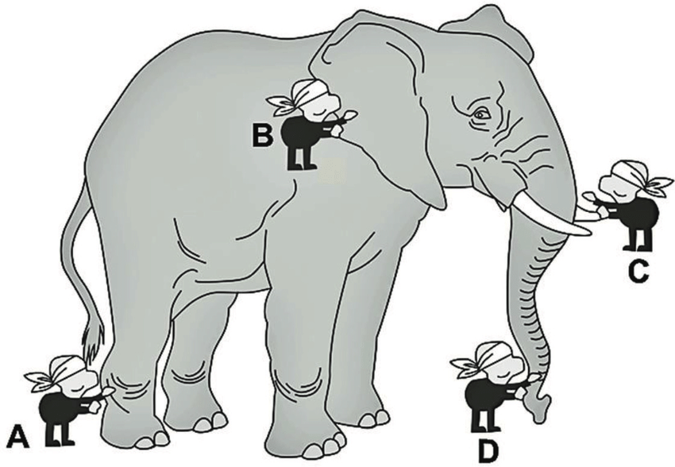
How do we make use of this?
Hypothesis: Health Record Data contains enough information to helpfully stratify patients with hypercapnic respiratory failure Consider:
OSA: frequently missed, associated with perioperative morbidity
STOP BANG score: Stratifies Risk of Undiagnosed Sleep Apnea
Subjective measures: Loud snoring, tired/fatigued/sleepy, observed apneas? Report of HTN Objective measures: BMI, Age, Neck Circumference, Gender
High Score = ↑ prevalence OSA, ↑ perioperative complications
Clinical Decision Rule/Score
Risk Stratification
Statistical Model
Machine Learning
Notes:
Find Farney’s Study
Image from TY - CHAP
AU - John, Maina
PY - 2017/07/12
SP -
SN - 978-953-51-3365-0
T1 - Application of Morphometric and Stereological Techniques on Analysis and Modelling of the Avian Lung
VL -
DO - 10.5772/intechopen.69062
ER -

Slide 27
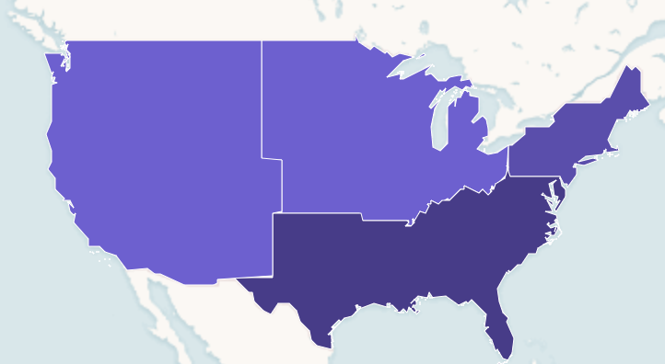
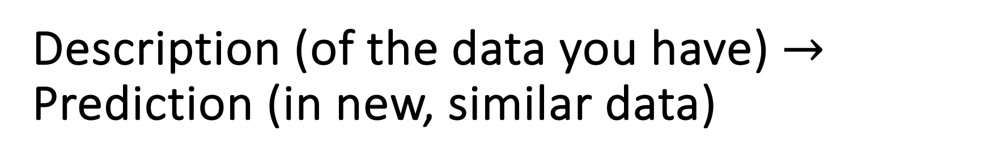
Description (of the data you have) $→$ Prediction (in new, similar data)
Same TriNetX Dataset*
Derivation: West, Northeast, Southwest
Validated: Midwest
Take structured data elements that are immediately available in the HER
Age, Sex, Serum HCO₃⁻ , Serum K⁺, Serum Creatinine, BMI, Hgb,
Venous BG
Output: Predicted Likelihood of Hypercapnia
V
D
D
D
Notes:
Traditional medical diagnostic studies describe uncertainty in the parameter estimate of a test characteristic on the patients studied, but what we really want to know is how well the test will work (and our uncertainty about that) when applied to a new population.
Moving from methods that minimize the RMSE of the sample (ie. explaining), to ones that minimize the error in the prediction of samples (often using bootstrapped samples)
Roles of LASSO:
-“Prediction in sample vs prediction out of sample”
-selecting a parsimonious set of predictors for out of sample
“Strictly speaking, one validates not a measuring instrument but rather some use to which the instrument is put.” (Nunnally, 1978, p.87)
LASSO etc.
Combine this and the next
https://www.geeksforgeeks.org/ml-bias-variance-trade-off/amp/
Dichotomization = easy to understand, but not very good use of information
Calibration: does the predicted risk = the actual risk
Cross-validation: resample (leaving one out) and assess stability to try to infer how well the model will work on another sample.
goal is to minimize the errors of predictions outside the people
“The bias-variance tradeoff states that the risk of an estimator can be decomposed into two components: a constant “bias” term, which reflects how far off the average value of the estimate is from the correct value; and an unbiased “variance” term, which accounts for the randomness of the sample.”
Stoddard:
Prognostic models, in general, tend to be overly optimistic. That is, the model appears to discriminate patients better in the dataset used for developing the model than it will in future patients. One source of such optimism is regression- towards-the-mean bias, where future patients tend to be more similar than was observed in the original sample. Another source is overfitting. To correct for the optimisim, the model should be calibrated to allow for such “shrinkage.”
For rationale:
Causes of poor calibration are:
statistical overfitting (not likely given size of dataset
Heterogeneity in populations in terms of patient characteristics, disease incidence or prevalence, patient management, and treatment policies
Aim 1 and 2:
Calibration - particularly important for models that support decision-making.
https://bmcmedicine.biomedcentral.com/articles/10.1186/s12916-019-1466-7
Calibration is particularly important because decisions are often made at thresholds.
Reasons for poor calibration:
shifting to a different incidence population
changing patients or management over time
overfitting
changes in the measurement error of the predictor variables.
Levels of callibration:
Mean calibration aka “calibration in the large” = average predicted rate = overall event rate. Calibration intercept = 0
Weak calibration - on average the model doesn’t over- or underestimate risk and does not give too extreme or too modest estimates. = calibration intercept (=0) and calibration slope (=1)
Moderate calibration = in each strata, the predicted number of people have the event. Assessed with calibration curve.
Strong calibration = predicted risk and actual risk correspond for all combations of predictors. Utopic goal
Call it a SCORE? - might be overstating validity to clinical use initially. Though eventually could be built out to fill this role.
LASSO -
A method of feature selection where you algorithmically shrink the coefficients of less important variables to 0
—lasso regression works like a feature selector that picks out the most important coefficients, i.e. those that are most predictive (and have the lowest p-values)

Slide 28
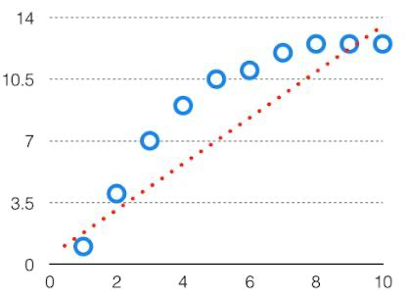
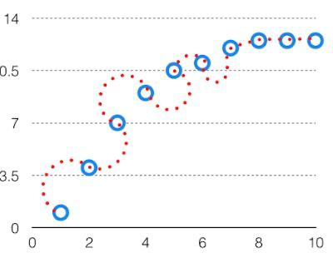

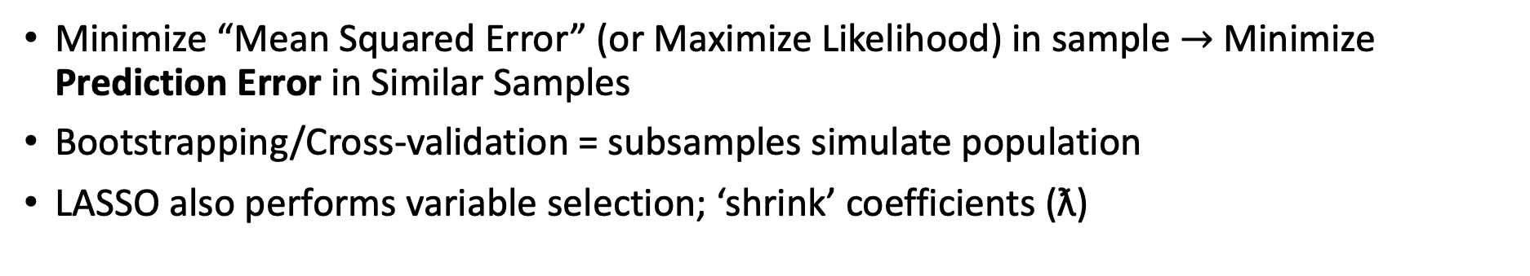
Least Absolute Shrinkage and Selection Operator (LASSO) Logistic Regression
Bias | Variance
Miss the signal (underfitting) | Fitting the noise (overfitting)
Too far in either direction = worse performance with new data.
Population
Sample
Subsample
Minimize “Mean Squared Error” (or Maximize Likelihood) in sample $→$ Minimize Prediction Error in Similar Samples
Bootstrapping/Cross-validation = subsamples simulate population
LASSO also performs variable selection; ‘shrink’ coefficients (ƛ)
Quantitude Podcast: LASSO
Notes:
Desired Specs:
REALLY simple: Usable by researchers (available as ShinyApp on my github). No ML*
Usable on different data-sets:
e.g. NHIS (ICD codes & demographics only), health record data (more data elements)
Probabilistic: Give either a categorical (v. low, low, high, v. high) or numerical prediction.
Some tasks warrant high specificity; others high sensitivity. Allows researcher discretion
Traditional medical diagnostic studies describe uncertainty in the parameter estimate of a test characteristic on the patients studied, but what we really want to know is how well the test will work (and our uncertainty about that) when applied to a new population.
Moving from methods that minimize the RMSE of the sample (ie. explaining), to ones that minimize the error in the prediction of samples (often using bootstrapped samples)
“Strictly speaking, one validates not a measuring instrument but rather some use to which the instrument is put.” (Nunnally, 1978, p.87)
LASSO etc.
Combine this and the next
https://www.geeksforgeeks.org/ml-bias-variance-trade-off/amp/
Dichotomization = easy to understand, but not very good use of information
Calibration: does the predicted risk = the actual risk
Cross-validation: resample (leaving one out) and assess stability to try to infer how well the model will work on another sample.
goal is to minimize the errors of predictions outside the people
“The bias-variance tradeoff states that the risk of an estimator can be decomposed into two components: a constant “bias” term, which reflects how far off the average value of the estimate is from the correct value; and an unbiased “variance” term, which accounts for the randomness of the sample.”
Stoddard:
Prognostic models, in general, tend to be overly optimistic. That is, the model appears to discriminate patients better in the dataset used for developing the model than it will in future patients. One source of such optimism is regression- towards-the-mean bias, where future patients tend to be more similar than was observed in the original sample. Another source is overfitting. To correct for the optimisim, the model should be calibrated to allow for such “shrinkage.”
For rationale:
Causes of poor calibration are:
statistical overfitting (not likely given size of dataset
Heterogeneity in populations in terms of patient characteristics, disease incidence or prevalence, patient management, and treatment policies
Aim 1 and 2:
Calibration - particularly important for models that support decision-making.
https://bmcmedicine.biomedcentral.com/articles/10.1186/s12916-019-1466-7
Calibration is particularly important because decisions are often made at thresholds.
Reasons for poor calibration:
shifting to a different incidence population
changing patients or management over time
overfitting
changes in the measurement error of the predictor variables.
Levels of callibration:
Mean calibration aka “calibration in the large” = average predicted rate = overall event rate. Calibration intercept = 0
Weak calibration - on average the model doesn’t over- or underestimate risk and does not give too extreme or too modest estimates. = calibration intercept (=0) and calibration slope (=1)
Moderate calibration = in each strata, the predicted number of people have the event. Assessed with calibration curve.
Strong calibration = predicted risk and actual risk correspond for all combations of predictors. Utopic goal
Call it a SCORE? - might be overstating validity to clinical use initially. Though eventually could be built out to fill this role.
LASSO -
A method of feature selection where you algorithmically shrink the coefficients of less important variables to 0
—lasso regression works like a feature selector that picks out the most important coefficients, i.e. those that are most predictive (and have the lowest p-values)

Slide 29
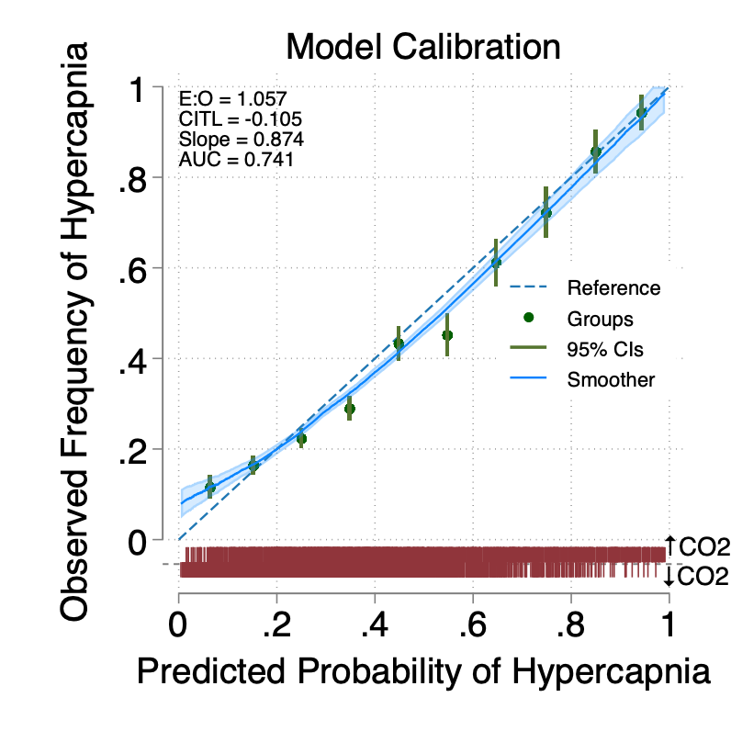
Preliminary Results
Sufficient for risk stratification, but not identification (yet)
Needs (true) external validation for particular uses.

Slide 30
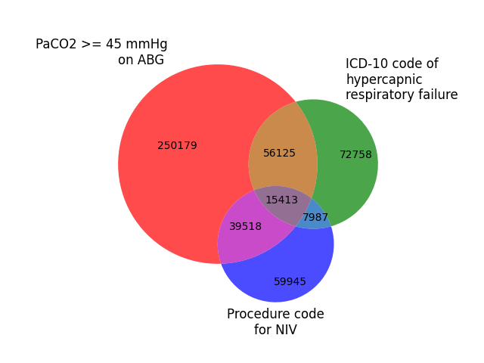
Impact of Risk Stratifying for Hypercapnia
Unmet Needs: Patients with hypercapnic respiratory failure are not well served by our scientific knowledge base
Evidence Gap: Identified cases are at high risk for adverse outcomes, but often we don’t have good evidence to inform management.
Implementation Gap: We unreliably diagnose hypercapnia in patients where best management practices are known
Better identification of patients with hypercapnia will allow:
For those with known effective management: improved care
Benchmark current health system diagnostic/management performance
Improve the rigor of research on multifactorial hypercapnia
Computable Phenotype: algorithms that use more information to label whether a patient has a disease.
How you decide who ”counts” as having hypercapnic respiratory failure influences the types of patients included.
Inaccurate disease status classification is a problem for existing EHR-based research
Notes:
[ ] Simplify this slide.
Revise the red portions.
What could you do with this?
Break the requirements for patients to have received an ABG to be correctly classified:
Create a cohort of patients with hypercapnia where enrollment is not contingent on providers recognizing the disease
Treat hypercapnic respiratory failure as an outcome (ie. med safety trials, air pollution) or properly as a covariate (adjusting on hypercapnia status)
Benchmark diagnostic performance and evaluate the influence of institutional, and individual sources of variation.

Slide 31

K23: 5-yr
Aim 2: Prospective Validation of PPV
Refinement and Validation of a method for identifying patients with hypercapnia that is robust to variations in the diagnostic process.
Aim 3: Evaluation of Prognostic Importance
Aim 1: Add Unstructured Data (NLP)
Statistical Modeling: Likelihood of Hypercapnia
Notes:
Aim our best to construct this cohort:
As a byproduct, we will also discover information about:
- proof of principle whether there are importantly missed patient out there
- insight into the likely impact of of those misses

Slide 32
Summary
Thanks to:
Thesis Advisory Committee:
Jeanette Brown MD PhD,
Ramkiran Gouripeddi MBBS MS,
Krishna Sundar MD
& Collaborators:
Wayne Richards MS,
Joseph Finkelstein MD PhD MA
& Funders
NIH T32; Robert Paine III MD
ATS ASPIRE Fellowship
The current diagnosis of hypercapnic respiratory failure is haphazard and suboptimal, which hinders patient care and reliable research.
Better use of health record data can help address both problems.
We’ve identified novel predictors and developed preliminary risk stratification
More sophisticated modeling is needed to maximize impact.
Brian.Locke@hsc.utah.edu

Slide 33
OVERALL: Patients with Consequentially Missed Hypercapnia can be Identified Using Health Record Elements | OVERALL: There is a significant burden of unrecognized hypercapnia among hospitalized patients. 3 aims
 | Aim 1: Add NLP; Retrospective Validation | Aim 2: Prospective Validation | Aim 3: Assess Potential Impact
Hypothesis | NLP-derived predictors and fine-tuning the model will improve accuracy for local use. | Patients with hypercapnia that are not recognized can be identified using health record elements with high positive-predictive value. | Inpatients who were predicted, but not confirmed, to have hypercapnic respiratory failure are at high risk of adverse outcomes.
Rationale | Unstructured data (signs/symptoms) may improve accuracy substantially. | Must be verified that model identifies unrecognized hypercapnia | Need to confirm that the identified patients face elevated risk (ABG PaCO₂ is an imperfect reference standard).
Approach | Assess calibration and validation of based, locally pre-trained LLM-based, and general LLM models | Non-invasively sample (with TcCO2) patients predicted to have hypercapnia that teams have not recognized | Among patients with an admission for hypercapnia that is identified, how many had preceding admissions likely to have hypercapnia? Readmissions?
Design | Retrospective, U of U | Prospective, U of U | Retrospective, ?VA vs Utah Facilities
Payoff: Allow hypercapnic respiratory failure -not dependent on clinician identification- as an exposure or outcome
Career Development: Development and prospective validation of bioinformatic tools require a unique skillset
Notes:
[ ] update this
Want to emphasize: use this technology to DO BETTER RESEARCH

Slide 34
Aim 1: Incorporate Unstructured Data
Other scores use data points you can’t get from structured fields
(=can only take specific values e.g. labs)
Objective 1: Develop NLP Pipeline
Natural Language Processing, Large Language Models (e.g. ChatGPT)
Data source: Nursing triage assessments
Aim: identify signs/symptoms/milieu predictive of ↑CO2
Locally pre-trained (all triage notes?); fine-tuned on labeled set of ~1000 (review)
Objective 2: Integrate with previously derived model
Apply to retrospective data from the University of Utah.
Reference standard: patients who had arterial blood gasses obtained.
Adjust model weights
Generate measures of model performance (discrimination and calibration) to inform other aims
OSA
STOP BANG
Subjective measures: Loud snoring, tired/fatigued/sleepy, observed apneas? Report of HTN Objective measures: BMI, Age, Neck Circumference, Gender
High-risk = increased perioperative complications
1990: Run a big enough prospective study and ask everyone
2023: Get “ChatGPT” (an LLM) to do it from documentation
(not actually ChatGPT- HIPAA/Data use )
Notes:
An important element not discussed here is the local fine-tuning that must occur.

Slide 35
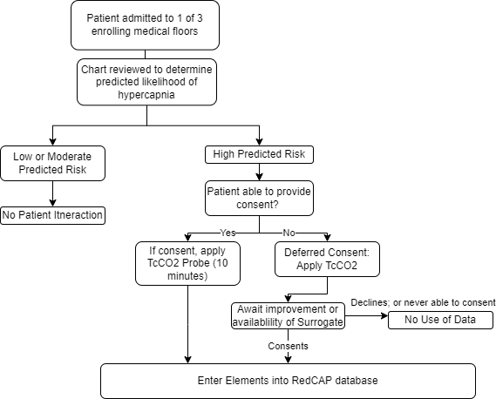

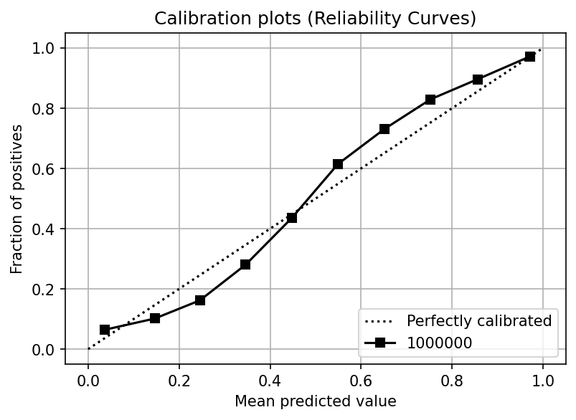
Aim 2: Prospectively Validate: UUH Inpatients
Deferred consent (CO₂ Narcosis)
Verify Positive Predictive Value (precision) in predicted high-risk patients with Transcutaneous CO2
Smaller sample stratified sampling of the whole population.
Prioritizes proof of concept rather than delineating scope of the problem (initially)
Sample Size Calculation: ~50-100
Rate of presentation to hospital: *** (TriNetX)
% Predicted High Risk: (10%)
% of eligible enrolled
25% ‘prevalence’ (Nowbar); model AUC; Se/Sp TcCO2 for true reference standard 85%/85%
Notes:
How will this fail?
Aim 1 results will influence needed sample size
Can I access EHR data fast enough?
Hawthorne effect? Due to hypoxemia (elevation), do they get identified earlier?
stata diagsampsi

Slide 36
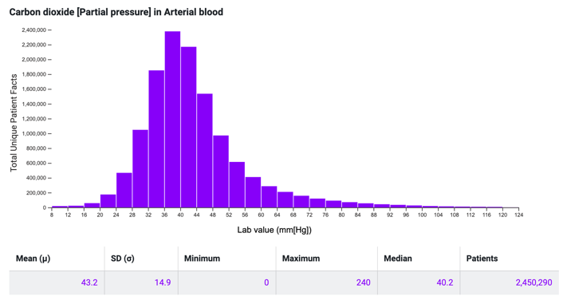
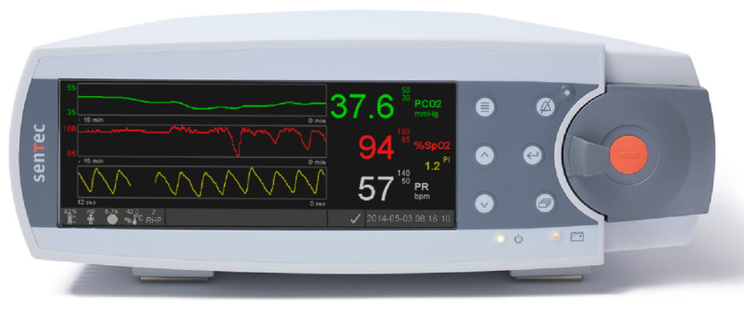

Prior work:
Tool | Health Record-Based Modeling | Transcutaneous CO2
Purpose | Refine Estimation of Pre-test Odds of Hypercapnia | Allow non-invasive CO2 assessment (patients unlikely to consent for research ABGs)
Limitation | Approach only externally validated in outpatient OHS assessment | Prior 95% agreement +/- 6 mmHg insufficient for unstratified clinical use
…
49: Correct 93%, Wrong 7%: weight: 1.98%
48: Correct 88%, Wrong 12%: weight: 2.39%
47: Correct 80%, Wrong 20%: weight: 2.47%
46: Correct 69%, Wrong 31%: weight: 2.92%
45: Correct 57%, Wrong 43%: weight: 3.11%
SENSITIVITY
SPECIFICITY
44: Correct 57%, Wrong 43% 3.56%
43: Correct 69%, Wrong 31% weight 3.73
42: Correct 80%, Wrong 20% weight 4.16%
41: Correct 88%, Wrong 12% weight 4.25%
40: Correct 93%, Wrong 7% weight 4.58%
….
Expected test characteristics:
sensitivity = 89%
specificity = 92%
if
agreement ~6 mmHg
same distribution of CO2

Slide 37
Aim 3: Estimate the potential impact
Overdiagnosis: people who meet the definition of disease, but do not benefit from it
PaCO2 is an imperfect reference standard for what we care about: future harm
Possible – though not likely – clinicians already identify the important cases
Need a ‘loyalty cohort’: patients whose rehospitalizations would be captured.
All claims payor database?
Veterans Affairs
Or artificially constructed one from another data source.
Hypothesis: Patients predicted to have had hypercapnia that was not recognized have a similar or excess risk of subsequent readmission as those identified (by blood gas and/or ICD code)
Prior efforts use data points you can’t get from structured fields
(=can only take specific values)
Notes:
e.g. we don’t just want to focus on identifying more patients who would have a blood gas CO2 over 45 mmHg if it were checked… we want to identify the patients who have and are going to continue to have clinically important respiratory failure and, ideally, those who will benefit from known therapies.
Retrospective cohort of patients predicted but not recognized to have hypercapnia
Longitudinal, high % follow-up within-system (VA)
Number of ”predicted likely” visits before definitive recognition
Hazard of ED visit, admission, mortality (comparison: ABG confirmed, ICD confirmed, treated)
Prediction: patients likely to have hypercapnia incur similar to increased risk of those confirmed.
supports, but does not demonstrate, that recognition may be beneficial
Threats to validity:
Is it the hypercapnia risk, per-se? (negative controls)
Risk might be ameliorated by treatment
Risk among patients with hypercapnia is not binary [ie risk PaCO2=90 >>> 50]
Other relevant data: sources of variation in probability of obtaining ABG or VBG, referral to sleep

Slide 38
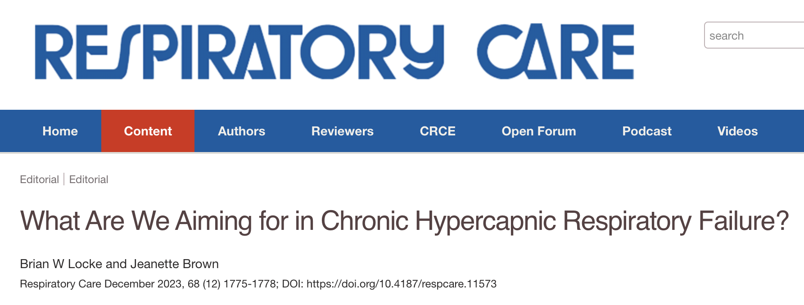
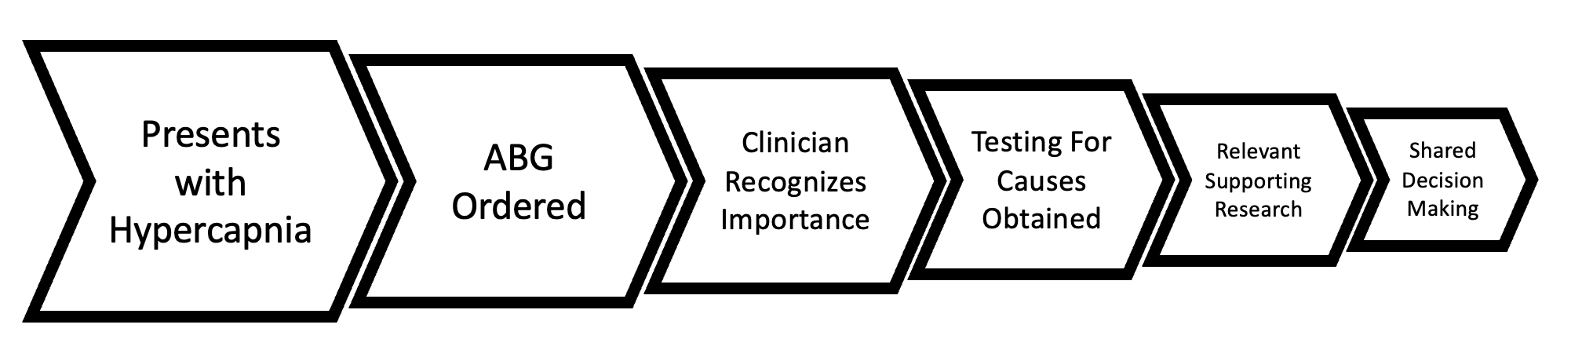
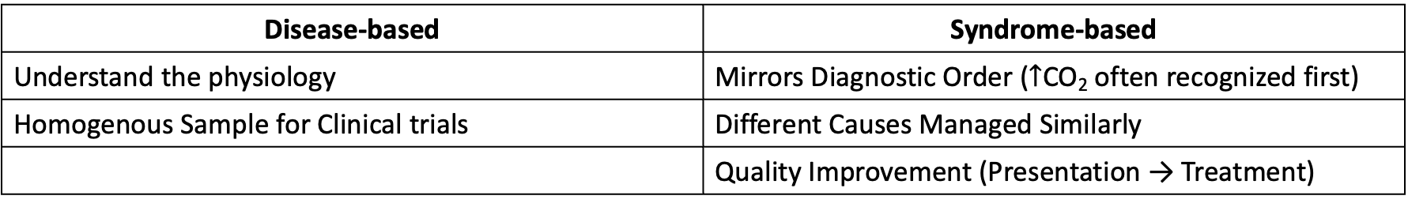
Disease-based Paradigm Doesn’t Mirror Practice
Disease-based | Syndrome-based
Understand the physiology | Mirrors Diagnostic Order ($↑$CO₂ often recognized first)
Homogenous Sample for Clinical trials | Different Causes Managed Similarly
 | Quality Improvement (Presentation → Treatment)
Notes:
Simplify or remove

Slide 39
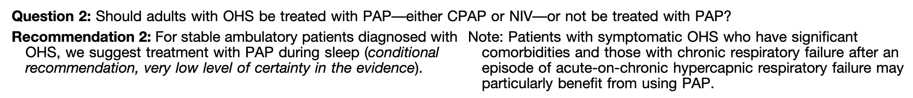

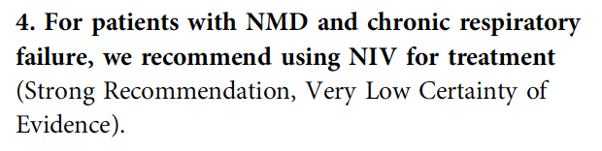
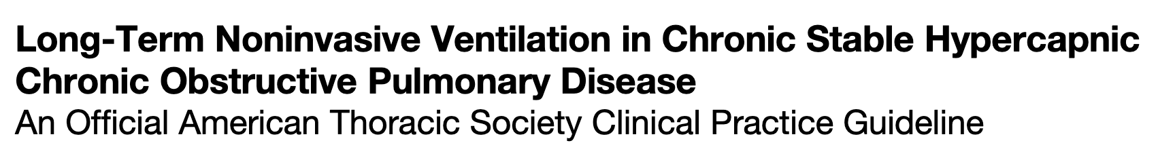
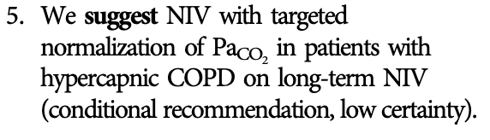
Hypothesis: We Can Identify Them & It Would Help?*
Notes:
Remove this slide.

Slide 40
Evidence Islands
COPD: PaCO2 > 52 mmHg when stable, OSA noncontributory
OHS: PaCO2 > 45 mmHg; No obstruction, AM Co2 up by 7 or PSG
Restrictive (including NMD) ABG 45>, or FVC < 50% or low muscle strength.
Obesity Hypovent
Severe COPD
ALS
Notes:
Hypercapnic respiratory failure is uncommon and can be acute or chronic.
The symptoms are variable, and the diagnosis is frequently missed.
Each case of hypercapnic respiratory failure may have several necessary causes.
Prior research exclusively focused on sufficient causes
Perhaps effect modification?
Patients who develop hypercapnic respiratory failure have many comorbidities that may act as confounders

Slide 41
Recognized Hypercapnia
What portion have applicable evidence-based management?
What portion of patients with hypercapnic respiratory failure qualify for NIV?
Does treatment help the others?
Obesity Hypovent
All Recognized Cases
(Multifactorial Causes,
Relapsing-Recurrent)
Severe COPD
???
ALS
Notes:
Hypercapnic respiratory failure is uncommon and can be acute or chronic.
The symptoms are variable, and the diagnosis is frequently missed.
Each case of hypercapnic respiratory failure may have several necessary causes.
Prior research exclusively focused on sufficient causes
Perhaps effect modification?
Patients who develop hypercapnic respiratory failure have many comorbidities that may act as confounders

Slide 42
All Hypercapnia
What portion of patients are missed?
Are the patients who are missed consequential?
All Cases
Obesity Hypovent
All Recognized Cases
(Multifactorial Causes,
Relapsing-Recurrent)
Severe COPD
???
ALS
???
Notes:
Hypercapnic respiratory failure is uncommon and can be acute or chronic.
The symptoms are variable, and the diagnosis is frequently missed.
Each case of hypercapnic respiratory failure may have several necessary causes.
Prior research exclusively focused on sufficient causes
Perhaps effect modification?
Patients who develop hypercapnic respiratory failure have many comorbidities that may act as confounders

